Slide 1
while Iteration Statement
ELEC1006: ENGINEERING COMPUTING

Slide 2

Iteration Statement (loops)
Loops are used to repeat a statement a certain number of times when a condition is met.
There are three types of loops:
while loop. ←
do-while loop.
for loop.
PAGE 2

Slide 3
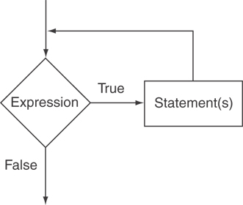
The while Loop
The format is:
while (expression or condition) { Statement(s) }
– repeat while “expression or condition” is true.
The logical flow of while loop:
PAGE 3

Slide 4
Example
// custom countdown using while
#include <iostream>
using namespace std;
int main ()
{
int n;
cout << "Enter the starting number: ";
cin >> n;
while (n>0) // Don’t put ; at the end
{
cout << n << ", ";
--n; // Decrement n by 1 in every loop
}
cout << "FIRE!\n";
return 0;
}
PAGE 4

Slide 5
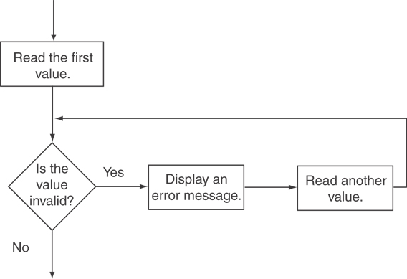
Input validation
cout << "Enter a number less than 10: ";
cin >> number;
while (number >= 10)
{
cout << "Invalid Entry!" << "Enter a number less than 10: ";
cin >> number;
}
PAGE 5

Slide 6
Tips: When to use while
Use while statement when the number of times the loop is required to run is unknown.
Use while (1) to form an infinite loop especially when using a simple program that runs for long periods of time, e.g. mobile phone call:
while (1)
{
read_input(); // 1) Get network data
process_data(); // 2) Convert into sound signal
output_data(); // 3) Play signal on speaker
if call_end()
break; // Break the while loop if call ends
}
PAGE 6

Slide 7
More info
[1] cplusplus.com: Statements and flow control
https://cplusplus.com/doc/tutorial/control/
[2] learncpp.com: 5.5 – While statements
https://www.learncpp.com/cpp-tutorial/55-while- statements/
PAGE 7

